Slide 1
Capstone Engagement, Hunter Headapohl
Assessment, Analysis, and Hardening of a Vulnerable System

Slide 2
Table of Contents
This document contains the following sections:
01
Network Topology
02
Red Team: Security Assessment
03
Blue Team: Log Analysis and Attack Characterization
Hardening: Proposed Alarms and Mitigation Strategies
04

Slide 3
Network Topology
3

Slide 4
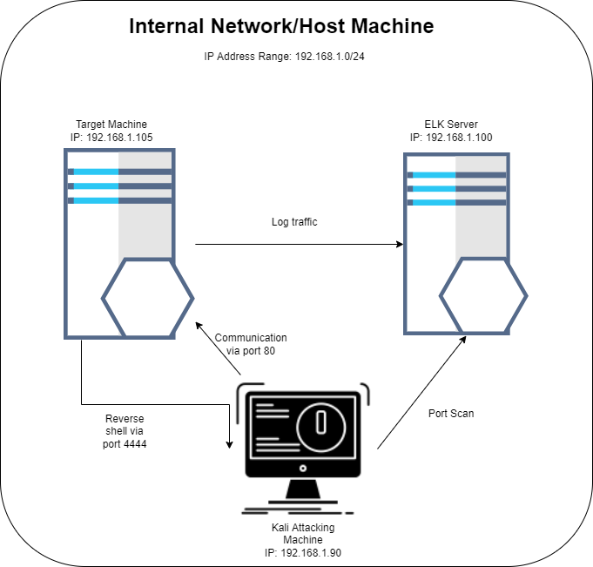
Network Topology
Network
Address Range: 192.168.1.0/24
Netmask: 255.255.255.0
Gateway: 192.168.1.1
Machines
IPv4: 192.168.1.1
OS: Windows 10
Hostname: Base HyperV
IPv4: 192.16.1.100
OS: Ubuntu Linux
Hostname: ELK Server
IPv4: 192.168.1.105
OS: Ubuntu Linux
Hostname: Capstone
IPv4: 192.168.1.90
OS: Kali Linux
Hostname: Kali

Slide 5

Red Team
Security Assessment
5

Slide 6
Recon: Describing the Target
Nmap identified the following hosts on the network:
Hostname | IP Address | Role on Network
HyperVisor Machine | 192.168.1.1 | Hosts the internal network and virtual machines using HyperV
ELK Server | 192.168.1.100 | Log management and visualization
Capstone | 192.168.1.105 | Webserver host/target machine
Kali | 192.168.1.90 | Penetration testing machine

Slide 7
Vulnerability Assessment
The assessment uncovered the following critical vulnerabilities in the target:
Vulnerability | Description | Impact
Local File Inclusion | LFI allows access into confidential files on a site | An LFI vulnerability allows attackers to gain access to sensitive files and credentials
Brute Force Vulnerability | Brute Force Vulnerabilities allow for the brute forcing of login credentials via a public facing webserver | A brute force vulnerability allows attackers to guess sensitive credentials and gain access to a system
Unauthorized File Upload | This vulnerability allows for the upload of arbitrary files to the target machine, in this case via WebDav | This vulnerability can enable an attacker to deliver an arbitrary payload to the target machine
Remote Code Execution | RCE is the ability to run arbitrary code on the target machine from a remote host | This vulnerability is critical. Once RCE is achieved the system is fully compromised.

Slide 8
Exploitation: Local File Inclustion
01
02
Method
We began by snooping around this website’s directories a bit. Company_folders/file1.txt, mentions the location of a secret folder.
When we insert the path to the secret folder in the URL, this supposedly secret directory was revealed and prompted us for credentials.
Achievements
This exploit achieved the exposure of a supposedly confidential folder to an attacking machine. While access is restricted without valid credentials, other vulnerabilities allow for the brute-forcing of those credentials and access to the secret directory.

Slide 9
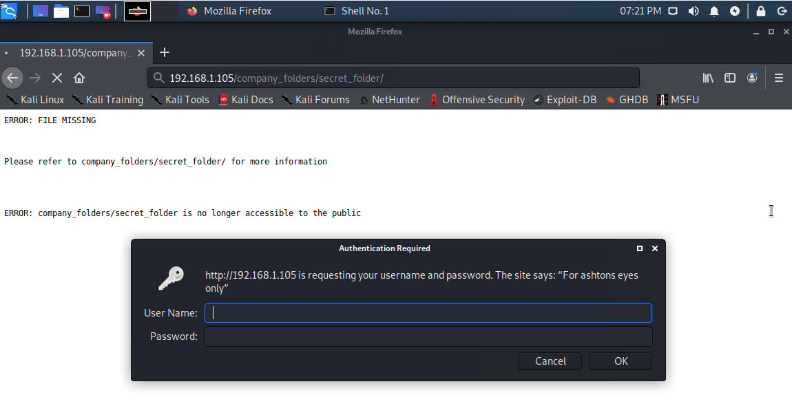
Exploitation of Local File Inclusion Vulnerability

Slide 10

Exploitation: Brute Force Vulnerability
01
02
03
Tools & Processes
Exploitation was achieved using Kali’s built-in brute forcing tool, Hydra, as well as the Rockyou wordlist. Hydra works by trying thousands of username and password combinations.
Method
Since the credentials prompt specifies “For ashton’s eyes only”, we can infer that the username is “ashton”. We attack this directory using Hydra from the Kali machine by running:
hydra -l ashton -P /usr/share/wordlists/rockyou.txt -s 80 -f -vV 192.168.1.105 http-get /company_folders/secret_folder
Outcome
The output of our hydra brute-force attack revealed the credentials combination “ashton:leopoldo”. When entered into the credentials prompt, we gain access to the secret_folder and the files contained inside.

Slide 11
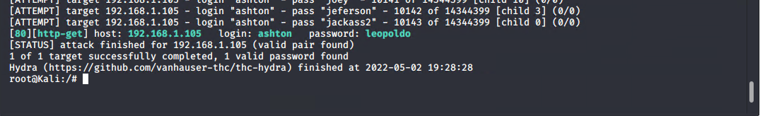
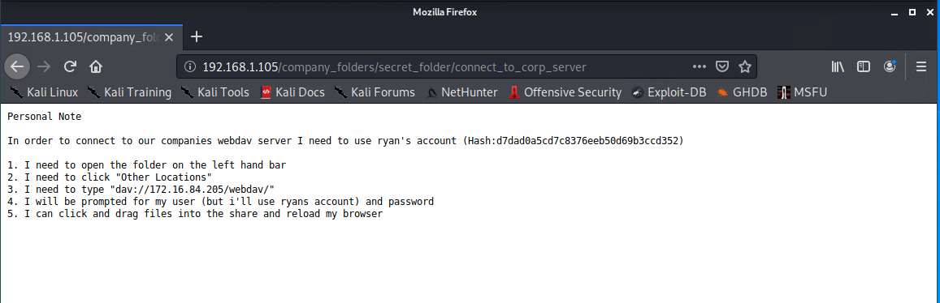
Exploitation of Brute Force Vulnerability
01
Output of Hydra
02
Contents of secret_folder/connect_to_corp_server

Slide 12
Exploitation: Unauthorized File Upload
01
02
03
Tools & Processes
CrackStation
Msfvenom
The WebDav tool
Method
Exploiting the vulnerability revealed in the secret_folder required three steps:
Crack the login credentials
Craft a PHP payload
Upload payload to target machine
Achievements
Cracking the WebDav login credentials with the provided hash yielded the credentials combination ryan:linux4u
Two PHP payloads were created with msfvenom
We successfully logged in to WebDav using the cracked credentials and uploaded our malicious payloads to the target machine

Slide 13
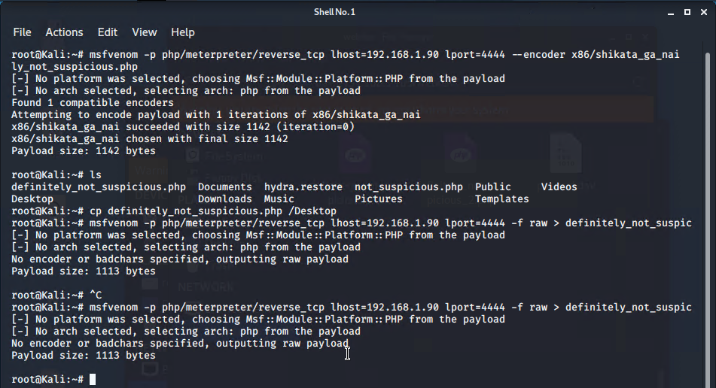
Anatomy of a payload
01
Two payloads were created using msfvenom: definitely_not_suspicious.php and definitely_not_suspicious_2.php
02
Both payloads use a PHP reverse shell set to call back to the kali machine(192.168.1.90) on port 4444.
One payload was encoded with x86/shikata_ga_nai to better evade antivirus software

Slide 14

Exploitation: Remote Code Execution
01
02
03
Tools & Processes
Msfconsole
Exploit multi handler
Meterpreter
Method
Exploiting the ability to execute an unauthorized file on WebDav required three steps:
Set up listener on msfconsole
Run the payload on target machine
Utilize Meterpreter shell to exfiltrate sensitive data
Achievements
Successfully ran arbitrary code (definitely_not_suspicious_2.php) on the target machine
Successfully gained a reverse Meterpreter shell using malicious payload
Successfully located “flag.txt” containing sensitive information

Slide 15
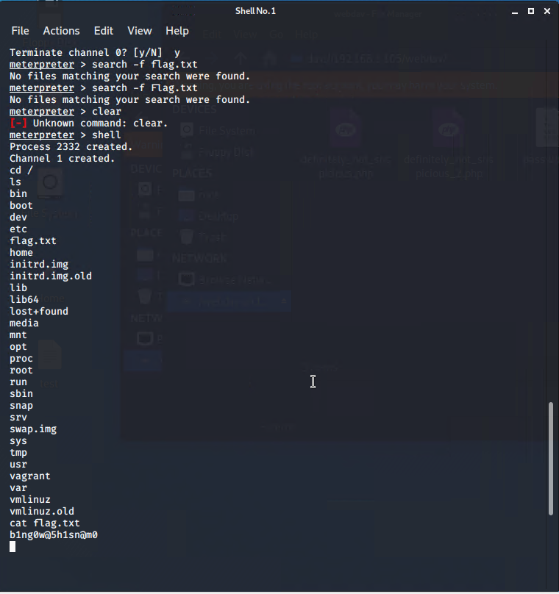
Example: Remote Code Execution
02
By running our malicious payload on WebDav, we were able to establish a reverse shell from the target machine to our Kali machine. The Meterpreter shell it contained allows us to run arbitrary commands and code on the target machine.
In this case, it allowed us to search the directories for sensitive information contained in flag.txt. We can view this file to reveal the secret: b1ng0w@5h1sn@m0

Slide 16

Summary of Exploitation
01
02
03
04
Local File Inclusion
Used local file inclusion to navigate to a secret_folder containing sensitive information
Brute Force
Used a brute-force attack with Hydra to discover the login credentials to the secret folder “ashton:leopoldo”
Then, we brute-forced the password hash for the credentials to the corporate server
Unauthorized File Upload
We then utilized these cracked credentials to upload an unauthorized PHP payload to the target server
Remote Code Execution
By running this payload, we gained a reverse shell and Meterpreter session on the target, allowing us to find and exfiltrate sensitive information

Slide 17

Blue Team
Log Analysis and Attack Characterization
17

Slide 18

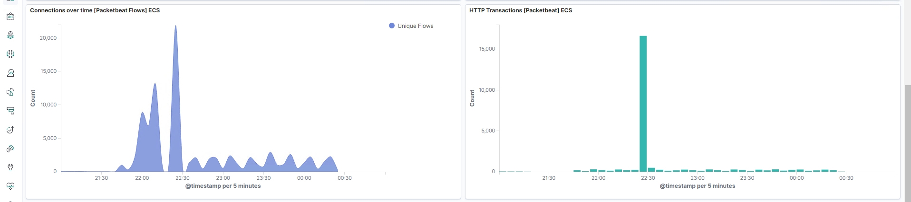
Analysis: Identifying the Port Scan
The initial spike occurs at approximately 22:00 ET.
A large spike in traffic from a single IP indicates a port scan.
[Insert Here]
Include a screenshot of Kibana logs depicting the port scan.

Slide 19
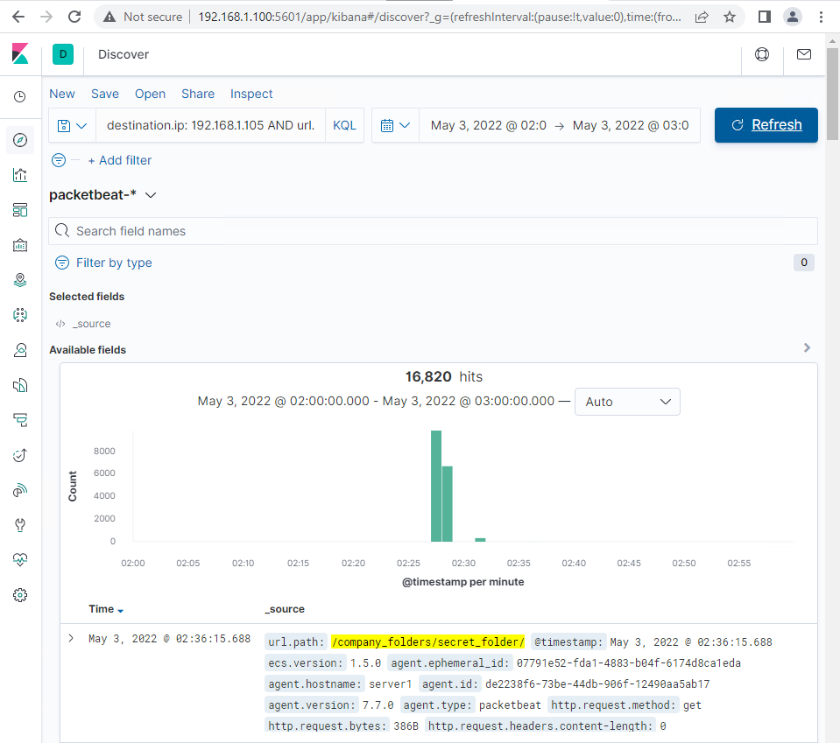
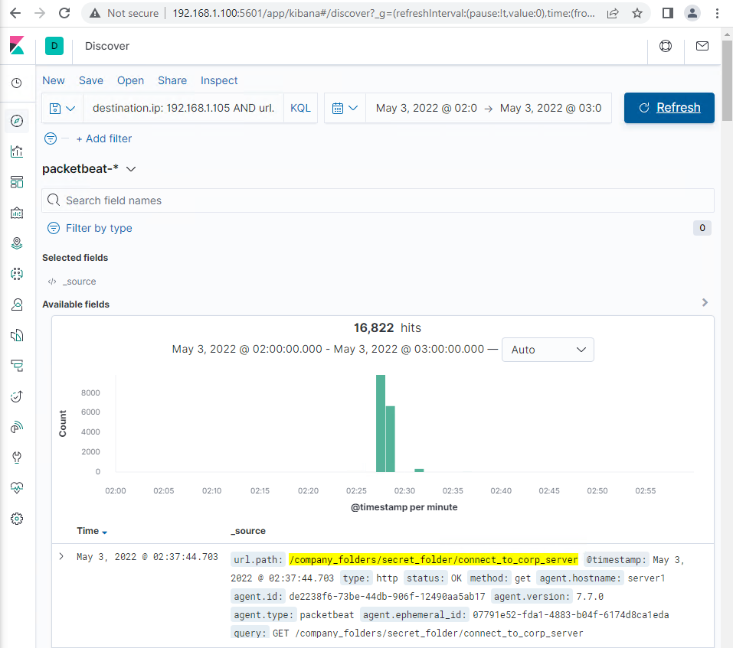
Analysis: Finding the Request for the Hidden Directory
At 22:25 ET, there were 16,820 requests for the secret directory.
These requests focused on the file secret_folder/connect_to_corp_server.

Slide 20
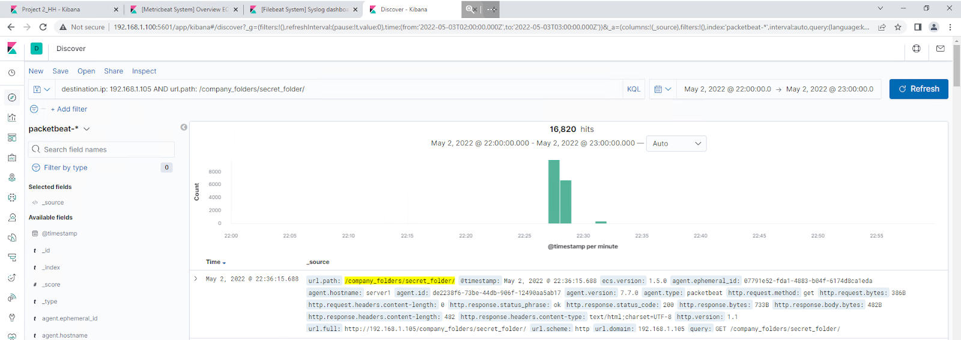
Analysis: Uncovering the Brute Force Attack
At 22:30 ET, We saw a massive spike in traffic (16,820 requests) indicating a brute force attack.
We found that it took 16,817 requests for the attacker to find the login credentials.

Slide 21
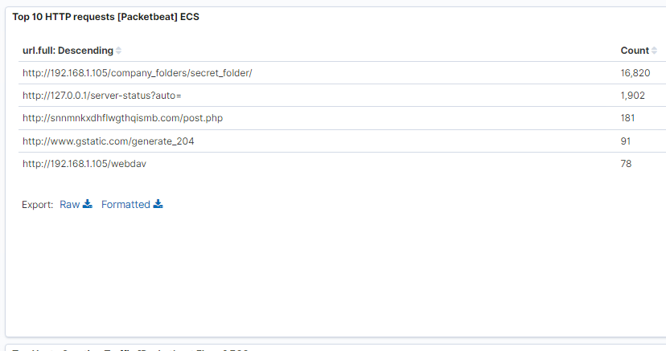
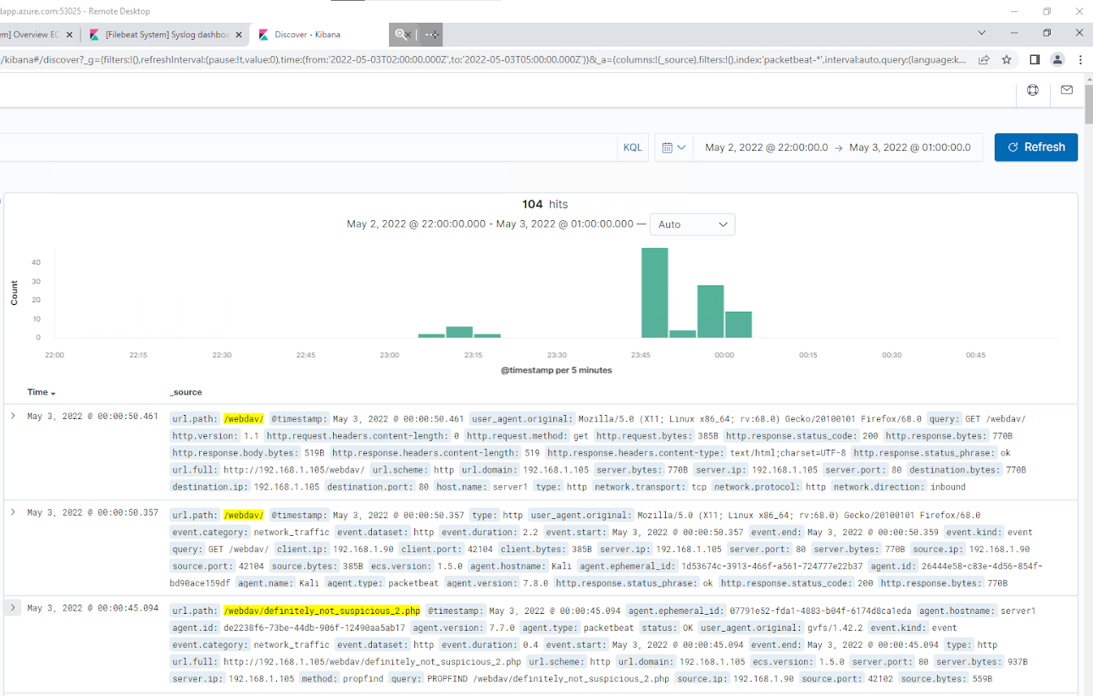
Analysis: Finding the WebDAV Connection
Our analysis found 78 requests for the WebDav corporate server.
The attackers requested one file in particular – definitely_not_suspicious_2.php.
We believe that this requested file was uploaded to the WebDav server and contains a malicious payload.

Slide 22
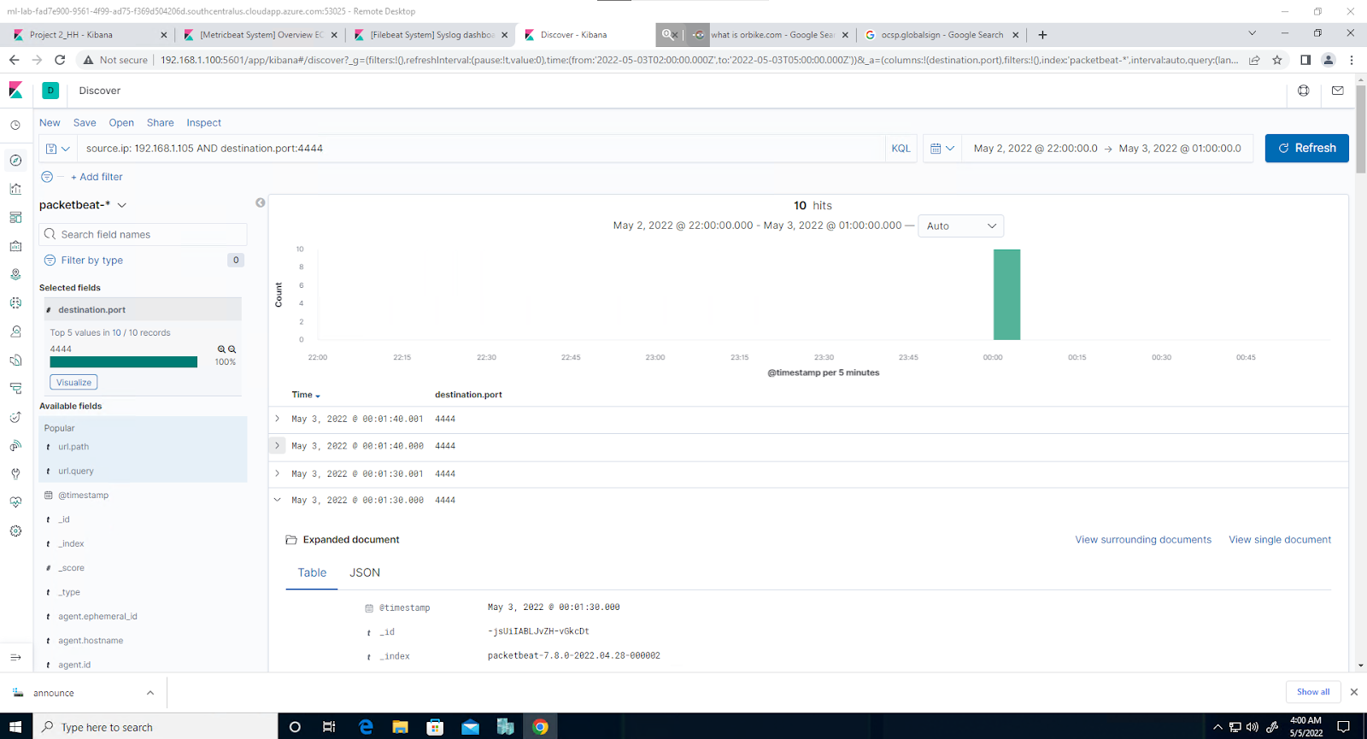
Analysis: Finding the Meterpreter Shell
Metasploit uses a default port of 4444 for reverse shells.
Filtering outgoing traffic on that port yielded 10 results. No traffic should use this port, so we can infer that this is an indication of a malicious shell running on the server.

Slide 23
Blue Team
Proposed Alarms and Mitigation Strategies
23

Slide 24
Mitigation: Blocking the Port Scan
Since a port scan involves a rapid series of incoming requests from a single source IP, we can set an alert to trigger when a certain rate of requests over time from a single source is reached.
Since port scan requests number in the thousands per second, we could set a threshold of 5000 in a single minute from a single IP.
Ideally, all systems would be behind a firewall or IDS of some kind that limits the ability of attackers to scan the network.

Slide 25
Mitigation: Finding the Request for the Hidden Directory
Since this secret directory should not be accessible from the open internet, we can set an alert to trigger any time an external IP address attempts to access this specific URL.
The threshold for this would be 1, since it should not be accessed by anyone.
The simplest defense against this vulnerability is not to keep a secret directory with secret files on a public-facing webserver.
If the directory must be kept, there should be a lockout after a certain number of authentication attempts to access that page over a short period of time.

Slide 26
Mitigation: Preventing Brute Force Attacks
Since a brute-force attempt will have many failed requests before success, we could set an alarm for a certain volume of HTTP error codes that indicate unauthorized login attempts (Error code 401).
A reasonable threshold would be 50 failed attempts inside of 5 minutes. This is because a human being will rarely exceed this threshold, whereas a brute force attack would violate this threshold easily.
One way to harden against this type of attack is to set a lockout threshold for failed login attempts. In this case, if there are over 10 failed login attempts for a single IP over the course of 10 minutes, we would block that user from attempting a login for a period of 1 hour. Every subsequent violation of this threshold increases the lockout period, making brute force attacks all but impossible.

Slide 27
Mitigation: Detecting the WebDAV Connection
The only people that should be able to access this corporate server are internal IP addresses from whitelisted employee machines.
We could set an alert anytime this server is accessed from a non-whitelisted IP address.
The biggest problem with the corporate WebDav server is that it is accessible from the open internet. One mitigation strategy is to limit access to this shared folder to an internal network or VPN. That way, only internal and/or authenticated connections can find and access the shared WebDav drive.
Ideally, the corporate share drive should not be on the same machine as the front-facing webserver

Slide 28
Mitigation: Identifying Reverse Shell Uploads
In terms of detecting a reverse shell upload, there are two alert strategies.
One is to set an alert anytime a POST HTTP request is generated for that location. This would indicate a file upload of some kind.
The other is to listen for outgoing malicious connections on non-standard ports. This can be achieved with an IDS or firewall.
File uploads to the WebDav server should be both authenticated and sanitized.
During the penetration test, we bypassed the authentication problem by stealing Ryan’s credentials. But the WebDav service still allowed us to upload clearly executable code to the server. This can be mitigated by proper data sanitization procedures.

Slide 29



Executive Summary
Penetration Test
Intrusion Detection
Recommendations
Vulnerabilities Found:
Local File Inclusion on Webserver
Brute Force Vulnerabilities
Unauthorized File Upload
Remote Code Execution
Activity Detected
Port Scan
Unauthorized access to secret_folder
Brute Force Attack
Unauthorized Upload
Suspicious traffic
Mitigations
Remove secret folders and files from site
Limit login attempts
Encrypt data at rest
Separate WebDav and public webserver
Authenticate and sanitize uploads to WebDav

